Slide 1
Teacher Laura The Solar System

Slide 2
CONTENT | COGNITION | CULTURE | COMMUNICATION
I will teach: The sun Names of planets that form the solar System- Main characteristics of the planets that form the Solar System (size and features) Language aims :-Present simple: ”to be” and ”to have”. -Hot/cold, big/small -Superlatives (the hottest, the coldest, the smallest, the biggest) -Ordinal numbers: first, second, third, fourth, fifth, sixth, seventh, eighth, ninth, last. -Planets: Mercury, Venus, Earth, Mars, Jupiter, Saturn, Uranus, Neptune ”To orbit” – Turn round , ” to rotate”, ”rotation”. Sun - Moon | - Understanding the relationship between the planets and their different features - Appling Knowledge of the planet’s characteristics-Comparing the different features of the planets- Knowing how to organize the information regarding solar system - Recognize and naming the PLANETS and their size Remembering the order of the planets in orbit around the sun- Draw the solar system.- Knowing how to complete a crossword puzzle on the information learned from the book.- Knowing how to complete the phrases concerning the proposed text | - Using the interactive board -Proposal for a visit to a Science Museum -Knowing the importance of respecting nature and planets | - Discussing in pairs.- Understand a text and represent it. - Produce and describe an image inserted in a well predetermined context. -Analyzing relationships -Writing planets names

Slide 5
Drawing about Solar System

Slide 8
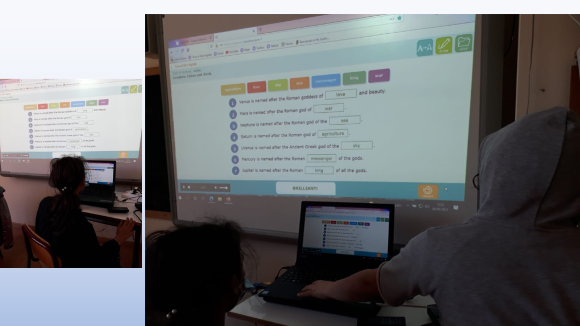

Slide 11
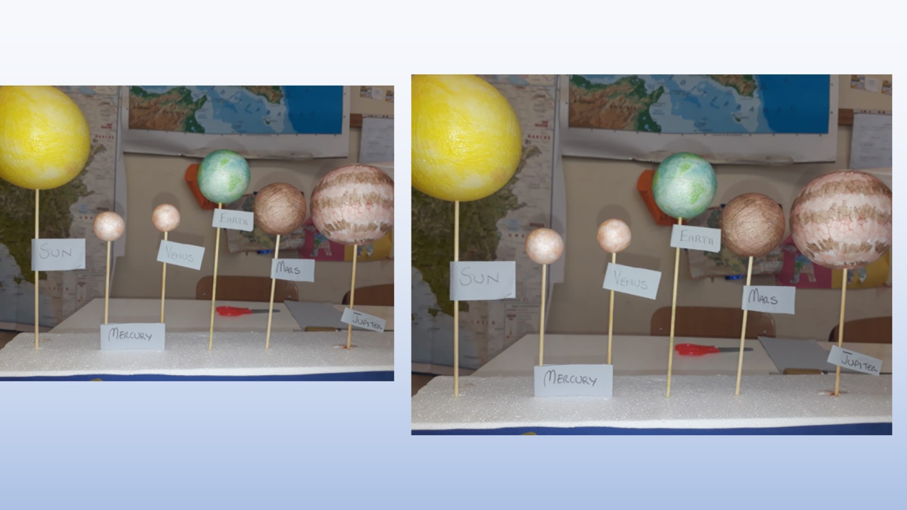

Slide 12
Activity 4 :Prodotto finale- Real task Learners create a model representing the Solar system and they discuss about distance of each planet from sun.

Slide 13
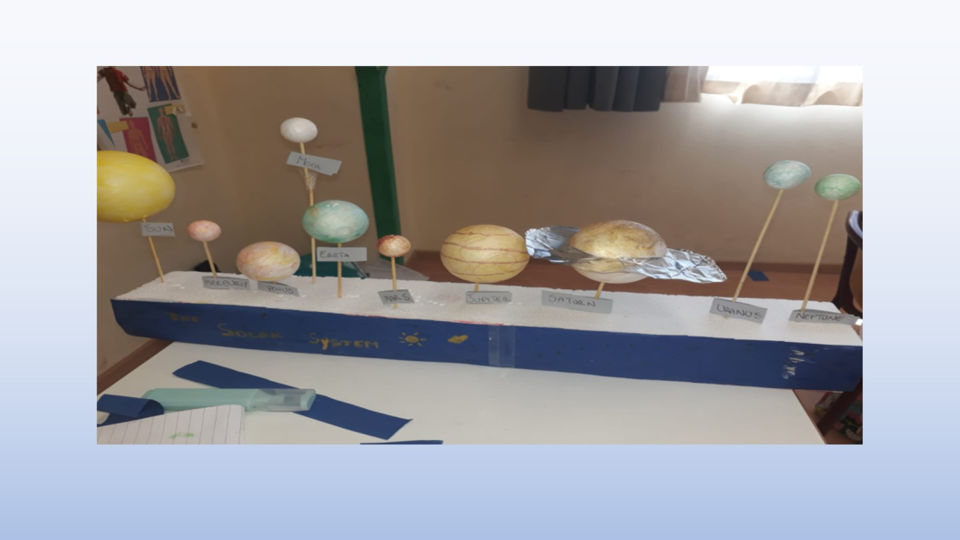

Slide 14
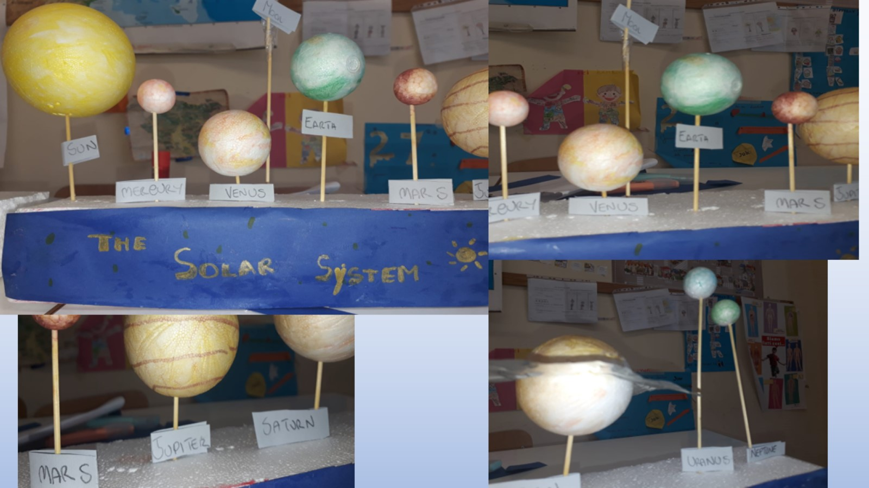

Slide 15
